Slide 1

Autonomous Operation for Last-Mile Delivery on Suburban Sidewalk
RBE550-Project Update
Keith Chester/Bob DeMont
Notes:
Hello and welcome to an update on our RBE550 project for Autonomous operations for last mile delivery on an urban sidewalk

Slide 2

A Couple of Changes
“No plan of operations extends with any certainty beyond the first encounter with the main enemy forces.”
-Prussian Field Marshal Helmuth von Moltke the Elder, 1871
With the extensive learning in Pygame for the homeworks and relatively little time left for learning ROS/Gazebo, we changed tools.
ROS/Gazebo out, Pygame in.
Notes:
We were ambitious at the onset of the project in wanting to execute it in ROS and Gazebo. With all the time we spent on homework with Pygame we decided to shift gears and use that tool for the simulation world for our project.

Slide 3
Goals
Our goals came into focus over the course of the lessons as we explored various search techniques.
Original Goals
Revised Goals
Planning and execution algorithms
Autonomous navigation
Obstacle avoidance
Static obstacles (boxes, trashcans)
Dynamic obstacles (people bikes)
Sidewalk rules
Staying on sidewalk
Crossing at crosswalk at green light
Simulation visualization in Gazebo
Planning and execution algorithms
Autonomous navigation
Global planner for high level navigation
Local planner for kinematic movement and obstacle avoidance
Obstacle avoidance
Static obstacles (boxes, trashcans)
Dynamic obstacles (cars)
Sidewalk rules
Staying on sidewalk for cars
Simulation visualization in Pygame
Notes:
Over the time of the course, we learned much more about various planners and their interactions; specifically the usefulness of a higher level planner for rough planning and a local planner for kinematic inclusion, movement planning and near obstacle navigation. These lessons learned encouraged us to change our original approach while trying to maintain original goals.

Slide 4
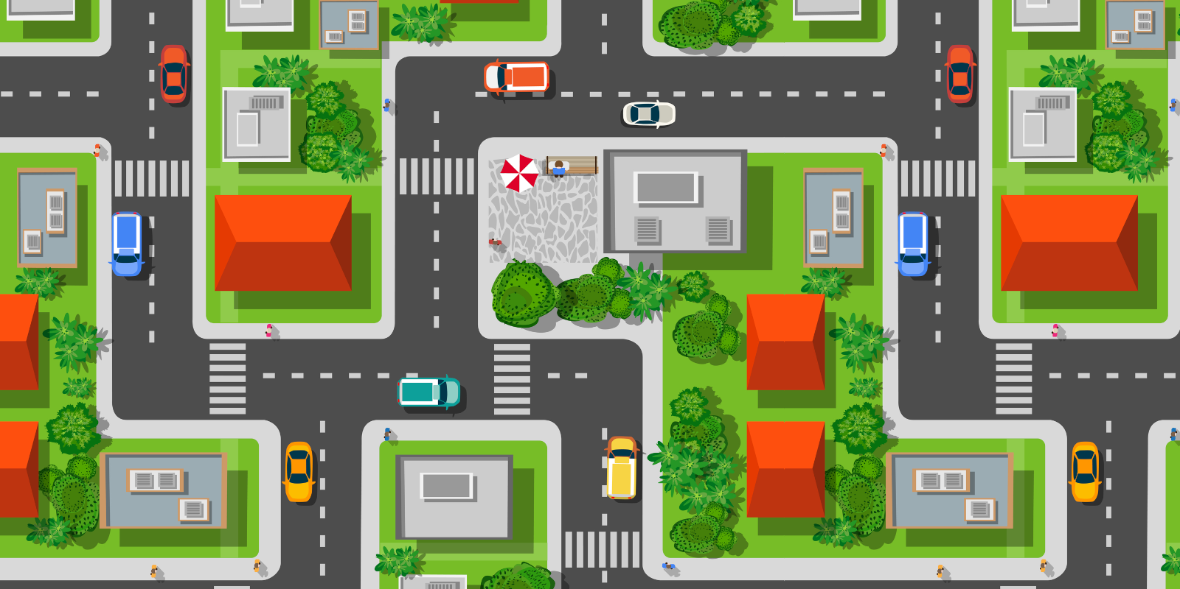
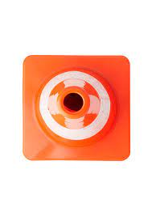
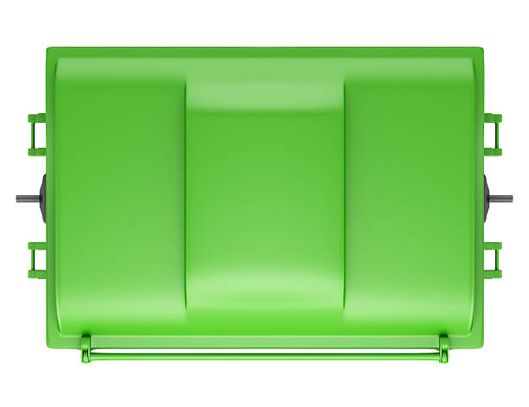
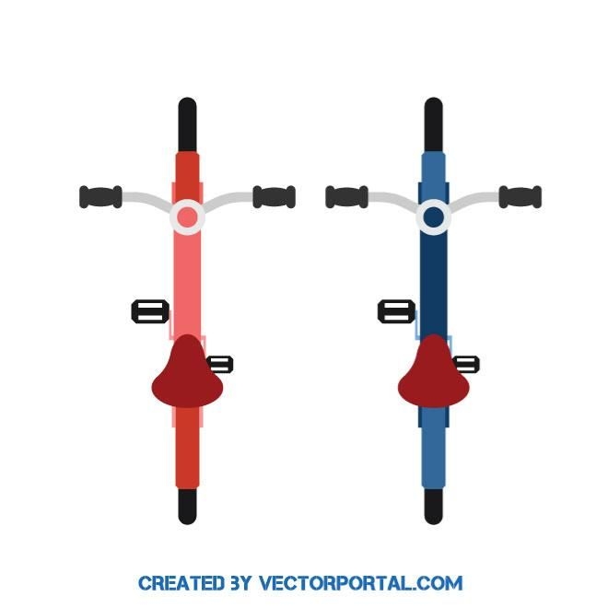

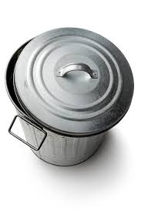
Our Environment
Trashcans
Vehicles
Cones
Dumpsters
Bikes
Notes:
Our environment is a suburban development with a grocery store near the center. The neighborhood has plenty of sidewalks, though they’ll get littered with obstacles before we know it. Typical obstacles we’ll model include traffic cones, dumpsters, bicycles, vehicles and trashcans.

Slide 5
Our Hero
Our delivery bot (Delbot) didn’t scale well but he’s there in sprite – I mean spirit!
Notes:
Our delivery bot is up to the task! Since his prettier image didn’t scale well down to our simulation level(1m per 15 pixels), we’ll represent him with the oriented yellow sprite with appropriate dimensions for the environment.

Slide 6
Our Hero’s Kinematics
Diwheel kinematics
Notes:
Based on research on existing robots in this field, We’ve modelled our hero as a diwheel robot since he has no steering short of the differential rotation of his wheels. Thus the kinematics are similar to the Valet work.

Slide 7
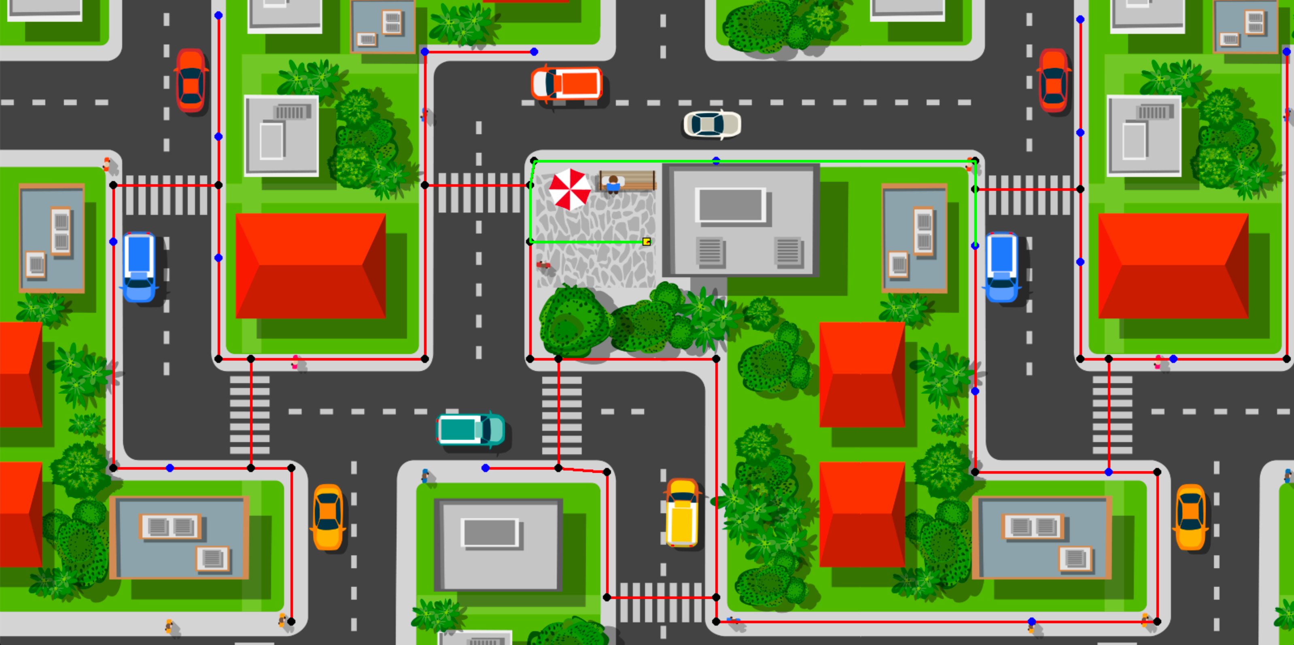
Approach
Global planner for the shortest path/local planner for movement
All nav aids/waypoints mapped and classified as corners, crosswalks and delivery addresses.
- Known navigation map
- Permitting an A* optimal search for shortest route to a delivery address
Here our hero is ready at the store near the center
For testing: Crosswalks and corners marked in black
Delivery addresses in blue
Notes:
Our global planner uses a known map with high level navigation points. Each corner, crosswalk, waypoint and delivery address is a node in the graph. Our A* planner optimizes the route to the delivery address prior to passing the path to the local planner.

Slide 8
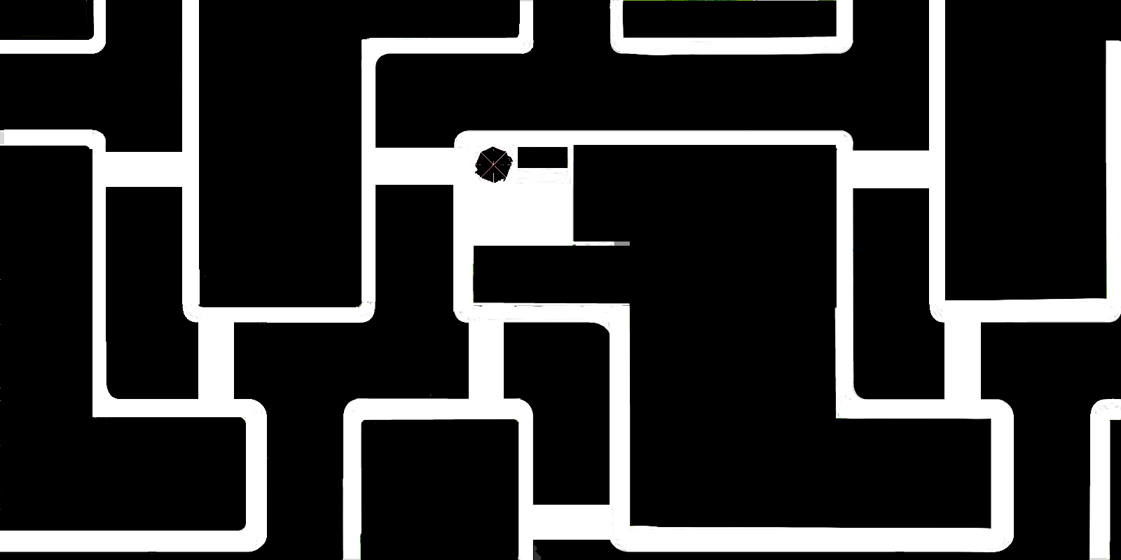
Approach(cont)
After the global planner determines the best path the local planner executes the movement.
We modeled diwheel kinematics to execute movement.
Collisions were detected on a shadow layer of the game using Pygame sprites and alpha layers (obstacles and their masks randomly inserted for each run)
Notes:
After the global planner determines the best path the local planner executes the movement. Collisions were detected on a shadow layer of the game using Pygame sprites and alpha layers. Obstacles and their masks will be randomly inserted for each run to exercise the local planner.

Slide 9
A* with Kinematic Constraints
Notes:
Using the diwheel kinematics for movements, we execute A* similar to the Valet exercise. The start and goal of each execution of the local planner is, in turn, each waypoint of the global planner’s path. We select the lowest cost node from the queue and determine either if it is the goal or if we can jump to the goal in one step within the kinematic constraints. If so, we trace back the parent tree and return the path. If not, we generate a list of neighbors from a subset of feasible kinematic movements and check if they cause a collision. If they do we reject, if they don’t we calculate the node’s costs and add it to the queue.

Slide 10
Results
We currently have :
the environment complete
Collisions detection methods working
Random delivery addresses generating
Global planning selecting optimized route
Local planner working
Notes:
So far we have the environment complete and the collision detection methods working. We have generated random delivery addresses for testing and generated global paths of an optimized route. We also have the local planner working to avoid obstacles which we discovered the hard way with alpha layer artifacts in our obstacle mask.

Slide 11
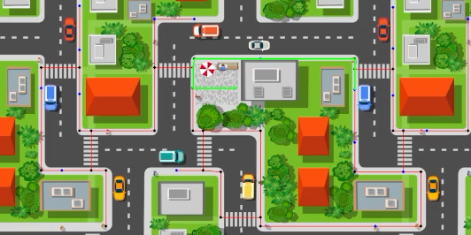
Global Planner Example
Notes:
Here is an example of the global planner in action. For testing, the network map is visible and we can see successive optimized paths to randomly selected deliver addresses.

Slide 12
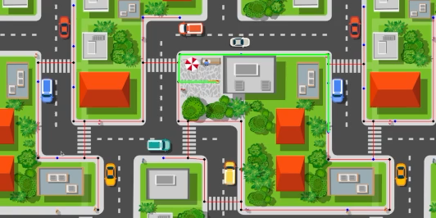
Local Planner Example
Notes:
Here the local planner takes the global path and generates a local path along it to the destination. You can see the red line extending along the network.

Slide 13
More Exploration
Over the rest of the week we plan to:
Complete debugging and tuning of the local planner
Add randomized environmental obstacles
-To the visual environment
-as well as the collision environment
Generate moving obstacles (cars)
Complete written report
Notes:
In the coming week, we plan to complete tuning of the local planner and add the addition of randomized obstacles to the environment. In order to check collisions, those will be obviously added to both the visual environment as well as the collision map. We plan to also generate moving obstacles with the cars to create a little game of Frogger for Delbot. And of course we’ll be completing the written report.

